Slide 1
Managing Information Technology Resources ITWS 4310
Project Management
September 20, 2018

Slide 2
Managing IT Resources Class Outline: Thurs, Sept 20, 2018
Becton Dickinson Recruiting Session
Gamma Nu Eta Company Expose (for those Registered)
Tonight from 7 – 9 PM in Academy Hall
Quiz
Current Events
Project Management and Gantter Primer Lecture and Discussion
Project Management In-Class Exercise for all Students Individually due Sept 23 by 9 PM
Begin Team Project Management Assignment In-Class Today
Submit Team Project Management Assignment by 9 PM on Sept 25
Project Teams meet with clients (recommended once per week) and invite instructors
Discuss and Agree on “Requirements”, “Schedule”, and ”CBA”

Slide 3
Managing IT Resources: ITWS 4310 Term Project Report Outline
Section 1: Executive Summary
Section 2: Introduction
Section 3: Client Organization and Description
Section 4: Project Team
Section 5: Problem Statement
Section 6: IS/IT Solution
Section 7: Methodology
Section 8: IS/IT Requirements
Section 9: IS/IT Design
Section 10: Cost-Benefit Analysis
Section 11: Project Plan/Schedule/Resources
Section 12: Post-Turnover Plan
Section 13: Results and Client Feedback
Section 14: Conclusions
Project Proposal
Requirements
Part of Initial Sections:
due Oct 9 by 9 PM
Cost-Benefit Analysis
Project Plan
due Sept 25 by 9 PM

Slide 4
Managing IT Resources: ITWS 4310 Term Project Thoughts
Establish Roles for each member of the Team and communicate those Roles to the Client
Project Manager
Technical Manager
Financial Manager
Client Liaison – Single point of contact for all client communications (copy all team members and instructor) – dual role for PM?
Establish regular meetings with Client
Have an agenda published before meeting
Always start and end on time
Project Manager chairs meeting
Always thank client for their time and support
Always send meeting minutes
Establish regular team meetings
Project Manager chairs meeting
Have an agenda and run meetings efficiently
Every member arrives on time and contributes
Every member turns in their portion of project deliverables on time to team for integration

Slide 5
Quiz 10 Questions 10 Minutes

Slide 6
Technology Current Events: “The EU is now going after Amazon after slapping Google and Apple with giant fines”, Insider, Sept 19, 2018. https://www.thisisinsider.com/amazon-investigated-by-eu-commissioner-margrethe-vestager-2018-9
The European Union is investigating another tech giant for potentially shady dealings — this time it's Amazon. In a press conference in Brussels on Wednesday, the EU's competition commissioner, Margrethe Vestager, answered a question from a journalist about whether the EU suspected Amazon of committing antitrust violations. She confirmed that her team had launched a preliminary investigation into how Jeff Bezos' company was using data from third-party sellers on its platform. It is not yet a formal inquiry, she added.
Explaining the thinking behind her exploratory work, Vestager said: "The question here is about the data, because if you as Amazon get the data from the smaller merchants that you host — which can be of course completely legitimate because you can improve your service to these smaller merchants — well, do you then also use this data to do your own calculations? What is the new big thing, what is it that people want, what kind of offers do they like to receive, what makes them buy things.”
Third-party sellers are an important part of Amazon's income, generating $9.7 billion of revenue in the second quarter of 2018, up 40% year-on-year. The company did not immediately respond to a request for comment. Amazon is already under pressure in the US over its market dominance. At the end of August, US President Donald Trump hinted that he thought Amazon, among other tech companies, could be a "very antitrust situation," and news emerged in September that US Attorney General Jeff Sessions was open to investigating Silicon Valley giants.
Vestager has a track record of taking tech companies to task. She handed Google a fine of $5 billion in July for anticompetitive practices related to its Android operating system. She also announced in August that her team was launching a review of smartphone chargers, which could spell trouble for Apple. Back in 2016, the EU forced Apple to pay $16 billion in back taxes to Ireland, which the company just finished paying.

Slide 7
Technology Current Events: “John Hancock will include fitness tracking in all life insurance policies”, VentureBeat, Sept 19, 2018. https://venturebeat.com/2018/09/19/john-hancock-will-require-fitness-tracking-for-all-life-insurance-policies/
John Hancock, one of the oldest and largest North American life insurers, will stop underwriting traditional life insurance and instead sell only interactive policies that track fitness and health data through wearable devices and smartphones, the company said on Wednesday. The move by the 156-year-old insurer, owned by Canada’s Manulife Financial, marks a major shift for the company, which unveiled its first interactive life insurance policy in 2015. It is now applying the model across all of its life coverage.
Interactive life insurance, pioneered by John Hancock’s partner the Vitality Group, is already well-established in South Africa and Britain and is becoming more widespread in the United States.
Policyholders score premium discounts for hitting exercise targets tracked on wearable devices such as a Fitbit or Apple Watch and get gift cards for retail stores and other perks by logging their workouts and healthy food purchases in an app.
In theory, everybody wins, as policyholders are incentivized to adopt healthy habits and insurance companies collect more premiums and pay less in claims if customers live longer.
Privacy and consumer advocates have raised questions about whether insurers may eventually use data to select the most profitable customers, while hiking rates for those who do not participate. The insurance industry has said that it is heavily regulated and must justify, in actuarial terms, its reasons for any rate increases or policy changes.
It is too early for John Hancock to determine if it is paying fewer claims because of its Vitality program, said Brooks Tingle, head of John Hancock’s insurance unit. But data it has collected so far about customers’ activities suggest that it will, Tingle said, as Vitality policyholders worldwide live 13 to 21 years longer than the rest of the insured population.

Slide 8
Project Planning: Scope and the Work Breakdown Structure

Slide 9
Introduction
Scope –
defines the work boundaries and deliverables of the project so what needs to get done, gets done – and only what needs to get done, gets done.
is determined directly by the project’s MOV.
Defines all the work, activities, and deliverables that the project team must provide for the project to achieve its MOV
Work Breakdown Structure – a project management tool that provides a hierarchical structure that acts as a bridge, or link, between the project’s scope and the detailed project plan that will be created.

Slide 10
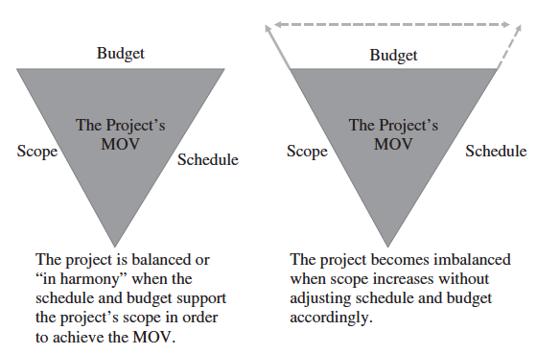
The Triple Constraint

Slide 11
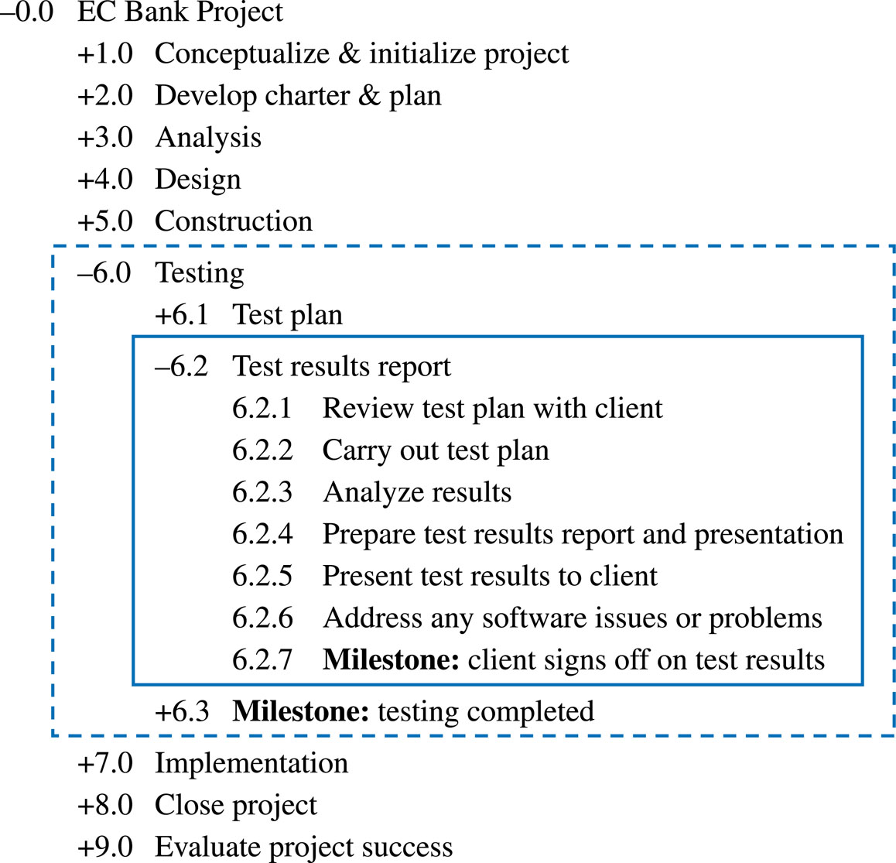
Example Work Breakdown Schedule

Slide 12
Project Planning: The Schedule and Budget

Slide 13
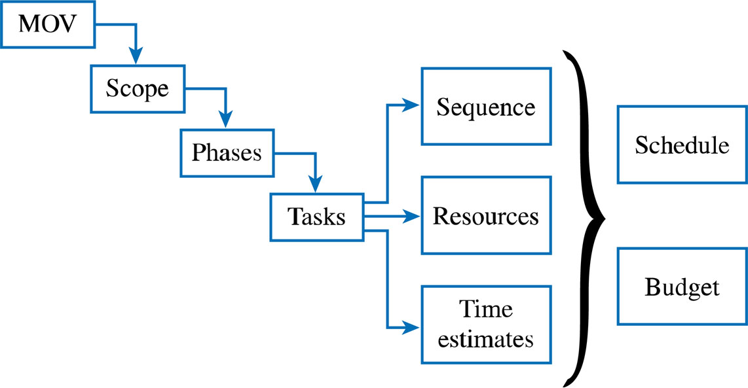
The Project Planning Framework

Slide 14
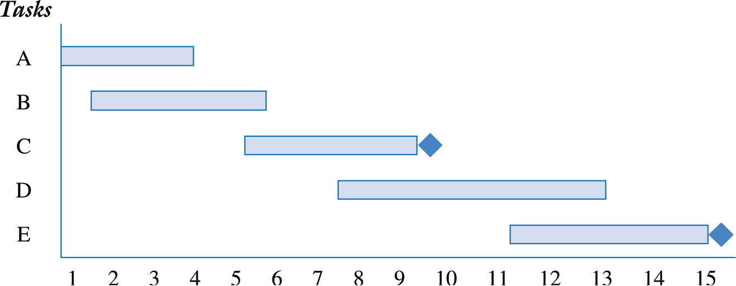
Gantt Chart for Planning

Slide 15
Lead and Lag Times
Lead is starting the next task before the first task is complete
Example: Begin installing the operating systems when half of the PCs are set up
Lag (or negative lead) is the adding of a buffer of time before the next task begins
Example: Once the walls have been painted, wait one day before laying the carpet so that the walls have had a chance to dry

Slide 16
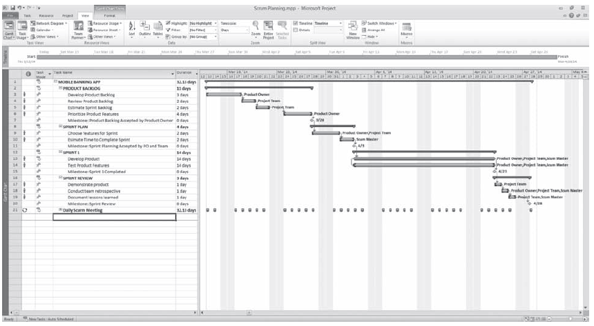
GANTT Chart in Microsoft Project ®

Slide 17
Developing the Project Budget
Define what resources will be needed to perform the work
Determine the quantity of resources that are needed
Define the cost of using each resource
Calculate the cost of the task or activity
Ensure that the resources are leveled, that is, not over allocated. An example of over allocation is assigning a project team member to two tasks scheduled at the same time.

Slide 18
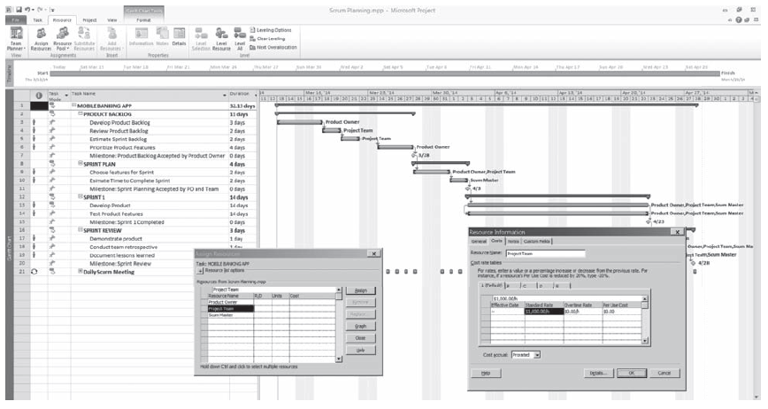
Project Resources Assigned to Project Tasks in Microsoft Project ®

Slide 19
Gantter.com In-Class Exercise
Get access to the free Cloud Based Project Application Tool, Gantter, at www.gantter.com
Choose the Gantter edition that is best for you from http://gantter.com/gantter-editions/ . I use the Gantter for Google Apps edition.
Do the In-Class Exercise using Gantter.

Slide 20
Project Management Software Tools In-Class Exercise with Gantter 1. Enter the Tasks noted below in a logical order in Gantter. 2. Enter and Indent the Tasks that are Sub-Tasks in a logical order within the broader Task 3. Enter the Task Duration for each Task or Sub-Task as noted below. 4. Enter the Resources and Cost for each Resource as noted below. 5. Establish the Predecessors and Link Tasks and Sub-Tasks as appropriate using Agile for Design, Construction, and Testing. 6. Estimate the Total Duration of the Project. 7. Estimate the Human Resource Costs detailed in this Project Plan. 8. For extra credit, investigate if you can reduce the total Project duration by adding Resources and what the Cost Impact would be.
Tasks and Sub-Tasks | Duration | Resources | Predecessors
Implementation | 30 days | CE 1, 2, 3 | Testing Complete
Milestone - Design Complete | 0 days |  | Design Integration of Frontend and Backend
Analyze Test Results | 2 days
Construction - Install Hardware | 30 days |  | Construction - Delivery Hardware
Test Plan | 2 days | CE 1, SE 1 | Design Complete
Develop Charter & Plan |  |  | Initialize Project Complete
Milestone - Construction Complete | 0 days
Design - Hardware | 5 days | CE 1, CE 2 | Analysis Complete
Analysis - CBA | 3 days | BA 1, BA 2 | Develop Charter and Plan
Construction - Plan | 10 days | CE 1, 2 | Design Complete
Close Project | 5 days | PM, TA 1, BA 1 | Implementation Complete
Construction - Delivery Hardware | 60 days | CE 10% | Construction - Order Hardware
Construction - Order Software | 5 days | SE 1, 2 | Design Complete
Milestone - Testing complete | 0 days
Testing
Construction - Software Delivery | 30 days | SE 10% | Construction - Software Order
Design
Carry out Test Plan | 5 days | QE 1, 2, SE 1, CE 1 | Test Plan Complete
Analysis - Technology | 3 days | TA 1, 2 | Develop Charter and Plan
Construction
Construction - Order Hardware | 5 days | CE 1, 2 | Design Complete
Initialize Project | 5 days | PM, TA 1, BA 1 | Project aligned with MOV and Strategy
Analysis
Develop Plan | 10 days | PM, TA1, BA 1 | Initialize Project
Evaluate Project Success | 5 days | PM, TA 1, BA 1 | Close Project
Design Requirements | 5 days | CE 1, SE 1, TA 1, BA 1 | Analysis Complete
Develop Charter | 5 days | PM, TA 1, BA 1 | Initialize Project Complete
Design Database | 4 days | SE 1, SE 2 | Analysis Complete
Analysis - Make/Buy | 5 days | PM, BA 1, TA 1 | Develop Charter and Plan Complete
Test Results approved by client | 3 days | PM, CE 1, SE 1, QE 1 | Carry out test plan complete
Design User Interface | 15 days | SE 1, DES 1, DES 2 | Analysis Complete
Design Integration of Backend and Frontend | 10 days | SE 1, SE 2 | Design UI and Design HW Complete
Resources | Abbreviation | Cost of Resource
Project Manager | PM | $150,000/yr
Technical Analyst | TA | $100,000/yr
Business Analyst | BA | $90,000/yr
Software Engineer | SE | $120,000/yr
Computer and Systems Engineer | CE | $110,000/yr
Quality Engineer | QE | $100,000/yr
Designer | DES | $100,000/yr

Slide 21
Gantter Project Primer
Managing IT Resources

Slide 22
View Tab
“Check” the following items:
Sidebar
Info Column
Duration Column
Work Column
Cost Column
Start Column
Predecessors Column
Resources Column

Slide 23
Project/Properties/General Tab
Create new project name
Set Calendar to 24-hour
Set Start date to 08/30/2018
Plan from Start date
Save

Slide 24
Project/Properties/Duration Tab
Hours in a day - 24
Days in a week - 7
Days in a month - 30
Save

Slide 25
Project/Properties/Time Defaults Tab
Default Start Time – 12:00 AM
Default Finish Time- 11:59 PM
Save

Slide 26
Resources Category
Add Resource Names
Individual team members (initials)
Team
Client contacts
Type is Work
Set Cost rate for each resource in $/hr

Slide 27
Tasks Category
Create tasks
For each task, Set Task Properties/Advanced
Type: Fixed duration, uncheck "Effort Driven”
Set task/sub-task hierarchy by indenting
Set estimated duration in days
Set dependencies between tasks - Predecessors
Set constraints, if any
Set Milestones as 0 duration

Slide 28
Allocation
Allocate resources to task
Set estimated work hours in Work column
If desired, adjust hours/resource/task - using resource usage %

Slide 29
Project Management Software Tools In-Class Exercise with Gantter 1. Enter the Tasks noted below in a logical order in Gantter. 2. Enter and Indent the Tasks that are Sub-Tasks in a logical order within the broader Task 3. Enter the Task Duration for each Task or Sub-Task as noted below. 4. Enter the Resources and Cost for each Resource as noted below. 5. Establish the Predecessors and Link Tasks and Sub-Tasks as appropriate using Agile for Design, Construction, and Testing. 6. Estimate the Total Duration of the Project. 7. Estimate the Human Resource Costs detailed in this Project Plan. 8. For extra credit, investigate if you can reduce the total Project duration by adding Resources and what the Cost Impact would be.
Tasks and Sub-Tasks | Duration | Resources | Predecessors
Implementation | 30 days | CE 1, 2, 3 | Testing Complete
Milestone - Design Complete | 0 days |  | Design Integration of Frontend and Backend
Analyze Test Results | 2 days
Construction - Install Hardware | 30 days |  | Construction - Delivery Hardware
Test Plan | 2 days | CE 1, SE 1 | Design Complete
Develop Charter & Plan |  |  | Initialize Project Complete
Milestone - Construction Complete | 0 days
Design - Hardware | 5 days | CE 1, CE 2 | Analysis Complete
Analysis - CBA | 3 days | BA 1, BA 2 | Develop Charter and Plan
Construction - Plan | 10 days | CE 1, 2 | Design Complete
Close Project | 5 days | PM, TA 1, BA 1 | Implementation Complete
Construction - Delivery Hardware | 60 days | CE 10% | Construction - Order Hardware
Construction - Order Software | 5 days | SE 1, 2 | Design Complete
Milestone - Testing complete | 0 days
Testing
Construction - Software Delivery | 30 days | SE 10% | Construction - Software Order
Design
Carry out Test Plan | 5 days | QE 1, 2, SE 1, CE 1 | Test Plan Complete
Analysis - Technology | 3 days | TA 1, 2 | Develop Charter and Plan
Construction
Construction - Order Hardware | 5 days | CE 1, 2 | Design Complete
Initialize Project | 5 days | PM, TA 1, BA 1 | Project aligned with MOV and Strategy
Analysis
Develop Plan | 10 days | PM, TA1, BA 1 | Initialize Project
Evaluate Project Success | 5 days | PM, TA 1, BA 1 | Close Project
Design Requirements | 5 days | CE 1, SE 1, TA 1, BA 1 | Analysis Complete
Develop Charter | 5 days | PM, TA 1, BA 1 | Initialize Project Complete
Design Database | 4 days | SE 1, SE 2 | Analysis Complete
Analysis - Make/Buy | 5 days | PM, BA 1, TA 1 | Develop Charter and Plan Complete
Test Results approved by client | 3 days | PM, CE 1, SE 1, QE 1 | Carry out test plan complete
Design User Interface | 15 days | SE 1, DES 1, DES 2 | Analysis Complete
Design Integration of Backend and Frontend | 10 days | SE 1, SE 2 | Design UI and Design HW Complete
Resources | Abbreviation | Cost of Resource
Project Manager | PM | $150,000/yr
Technical Analyst | TA | $100,000/yr
Business Analyst | BA | $90,000/yr
Software Engineer | SE | $120,000/yr
Computer and Systems Engineer | CE | $110,000/yr
Quality Engineer | QE | $100,000/yr
Designer | DES | $100,000/yr

Slide 30
Draft Term Project Development Plan using Gantter Assignment
Each student should establish a free Gantter account at http://gantter.com/
Review the Generic MITR Project Plan from LMS and import this file into your Gantter account.
Create a Gantter Project Plan for your Term Project. I recommend that you start from scratch, but you may use the Generic MITR Project Plan tasks as a template.
Use the Gantter Project Primer for MITR presentation to help set up your project plan.
Identify the tasks for your entire project. In particular, detail the development tasks related to the specific “System Requirements” for your Term Project. (The project plan should contain 70-100 tasks and include sub-tasks, dependencies, duration, work, and resources assigned to tasks)
Write a separate narrative section as a Word doc that:
summarizes the major phases of the project plan at a high level (description, start date, duration, work effort) and
identifies at least 2 risks that could affect your project and states how your team could mitigate or manage those risks.
Improve your plan by reviewing "Microsoft Project Plans" from past MITR Projects posted on LMS by importing into Gantter.
Submit the draft “Gantter Project Plan” and the associated narrative as a Word doc by 9:00 PM on Sept 25 on LMS.

Slide 31
Managing IT Resources Week 5 Assignments: Sept 24 – Sept 27
Each Student submit In-Class Exercise on Project Management by 9 PM on Sept 23
Each Team submit the Term Project Draft “Project Management Plan” by 9 PM on Sept 25
Read the Assigned Readings & Current Events articles posted on LMS prior to Class on Sept 24
Read “An Overview of Risk and Risk Management” included in the HBS Press Coursepack.
Read “Descriptive Statistics in Microsoft Excel” included in the HBS Press Coursepack prior to Class on Sept 27
Be prepared to take Quiz on readings and Current Events at beginning of Class on Sept 27
Be prepared to do In-Class Exercise related to Risk Analysis in Class on Sept 27
Work with Term Project Client on “Requirements” submit in “Initial Sections” by 9 PM on Oct 9

